Slide 1
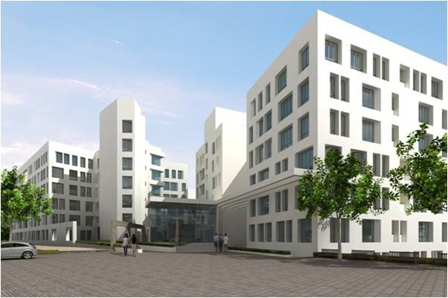

TRAINING & PLACEMENT DEPARTMENT
Shalaka Foundation’s
KEYSTONE SCHOOL OF ENGINEERING, PUNE
Committed for grooming global Engineers…

Slide 2









VISION
MISSION
Contents
GOAL
TPO PROFILE
INFRASTRUCTURE
INDUSTRY CONNECT
TRAINING
PLACEMENT

Slide 3

VISION...
The Vision of Training & Placement Cell is to Provide Personal and Career Related Support To Students With Special Emphasis on Training the Students on Employability Skills and Ultimately Provide Placements in Various Industries/Organization by Arranging Campus Placement Drives

Slide 4

MISSION...
Making Every Students Equipped With Comprehensive Professional Skill Relevant to Industry With Skill Development, Professionalism And Ethics
To Act an Active Interface Between Industry And Academia
To Make ‘Keystone’ a Trusted Brand Name for Organisations in Filed of Engineering & Technology . Organisation Will Look Towards Keystone for all Their Requirement
To Promote Innovation and Entrepreneurship by Providing State of Art Facilities and Incubation Centre

Slide 5

GOAL
Short Term.
To Provide Every Student Cent Percent Placement
Long Term.
To Provide Platform for Higher Education Opportunities Abroad and In India as Per Student Requirement
To Provide Opportunities for Entrepreneurship
To Provide Average Salary of Rs. 10 Lakhs in Five Year Times by 2028-29

Slide 6



Mr. Bharat Bhushan Sud
DEAN Training & Placements
He is graduated from reputed BITS PILANI in Mechanical
Engineering. He has completed his M.B.A. from Faculty of
Management Studies (F.M.S.) University of Delhi. He has vast Experience of Over 30 years with reputed national & multinational companies like Premier Automobiles, Hero Honda Motors, Mahindra & Mahindra, Automotive Axles Limited, Greaves Cotton Ltd., International Tractors Ltd. Kirlokar Group
Expert in a turn around of sick companies and make them profitable
Involved in setting up green filed projects like HERO HONDA, SAME DEUTZ, PIAGGO
Mr. Nitin Deshpande
Training & Placements Officer
He is graduated in BA (Psychology)and a post Graduated diploma in marketing Managment from IMOR Has a vast industry experiennce of over 35 years with various National & multinational Companies. Has been active incorporate training & a student connection. Has worked for companies EUREKA FORBES, KODAK, ZEE TV, CLUB MAHINDRA.
Notes:
Zoom Up Gears
(Advanced)
To reproduce the thumbnail images on this slide, do the following:
On the Home tab, in the Slides group, click Layout, and then click Blank.
On the Design tab, in the Themes group, click Colors, and then select Hardcover.
On the Insert tab, in the Media group, click Video, and then click Video from File.
In the left pane of the Insert Video dialog box, click the drive or library that contains the video. In the right pane of the dialog box, click the first video that you want and then click Insert.
On the Home tab, in the Clipboard group, click Copy, then select Copy.
Also on the Home tab, in the Clipboard group, click the arrow below Paste, and select Paste Special. In the Paste Special dialog box, select Paste, and then under As, select Picture (JPEG).
Select the new image, On the Home tab, in the Drawing group, click Arrange, point to Align, and then do the following:
Click Align Left.
Click Align Bottom.
On the Insert tab, in the Media group, click Video, and then click Video from File.
In the left pane of the Insert Video dialog box, click the drive or library that contains the video. In the right pane of the dialog box, click the second video that you want and then click Insert.
On the Home tab, in the Clipboard group, click Copy, then select Copy.
Also on the Home tab, in the Clipboard group, click the arrow below Paste, and select Paste Special. In the Paste Special dialog box, select Paste, and then under As, select Picture (JPEG).
Select the new image, On the Home tab, in the Drawing group, click Arrange, point to Align, and then do the following:
Click Align Center.
Click Align Bottom.
On the Insert tab, in the Media group, click Video, and then click Video from File.
In the left pane of the Insert Video dialog box, click the drive or library that contains the video. In the right pane of the dialog box, click the third video that you want and then click Insert.
On the Home tab, in the Clipboard group, click Copy, then select Copy.
Also on the Home tab, in the Clipboard group, click the arrow below Paste, and select Paste Special. In the Paste Special dialog box, select Paste, and then under As, select Picture (JPEG).
Select the new image, On the Home tab, in the Drawing group, click Arrange, point to Align, and then do the following:
Click Align Right.
Click Align Bottom.
Press and hold CTRL and select all 3 images.
Under Picture Tools, on the Format tab in the Size group, set the Height to 1.68” and the Width to 2.98”.
Select just the left image. Also under Picture Tools, on the Format tab in the Size group, click the arrow at the bottom right launching the Format Picture dialog box.
In the Format Picture dialog box, select 3-D Rotation in the left pane, under 3-D Rotation on the right pane do the following:
Click the arrow next to Presets, under Perspective, select Perspective Right.
Under Rotation, set the X box to 330 degrees.
Also in the Format Picture dialog box, select Position in the left pane, under Position on slide in the right pane set the Horizontal to 0.54” and the Vertical to 5.08”.
Also in the Format Picture dialog box, select Line Color in the left pane, under Line Color in the right pane select Solid line, then click the arrow to the right of Color and under Theme Colors select Black, Text 1 (first row, second option from left).
Also in the Format Picture dialog box, select Line Style in the left pane, under Line Style in the right pane, set the Width to 0.75 pt.
Also in the Format Picture dialog box, select Shadow in the left pane, under Shadow in the right pane, then click the arrow to the right of Presets and under Outer select Offset Diagonal Bottom Left (first row, third option from left).
Select center image. Under Picture Tools, on the Format tab in the Size group, click the arrow at the bottom right launching the Format Picture dialog box.
In the Format Picture dialog box, select Position in the left pane, under Position on slide in the right pane set the Horizontal to 3.51” and the Vertical to 5.12”.
Also in the Format Picture dialog box, select Line Color in the left pane, under Line Color in the right pane select Solid line, then click the arrow to the right of Color and under Theme Colors select Black, Text 1 (first row, second option from left).
Also in the Format Picture dialog box, select Line Style in the left pane, under Line Style in the right pane, set the Width to 0.75 pt.
Also in the Format Picture dialog box, select Shadow in the left pane, under Shadow in the right pane, then click the arrow to the right of Presets and under Outer select Offset Bottom (first row, second option from left).
Select third image. Also under Picture Tools, on the Format tab in the Size group, click the arrow at the bottom right launching the Format Picture dialog box.
In the Format Picture dialog box, select 3-D Rotation in the left pane, under 3-D Rotation on the right pane do the following:
Click the arrow next to Presets, under Perspective, select Perspective Left.
In the X box, enter 30 degrees.
Also in the Format Picture dialog box, select Position in the left pane, under Position on slide in the right pane set the Horizontal to 6.33” and the Vertical to 5.08”.
Also in the Format Picture dialog box, select Line Color in the left pane, under Line Color in the right pane select Solid line, then click the arrow to the right of Color and under Theme Colors select Black, Text 1 (first row, second option from left).
Also in the Format Picture dialog box, select Line Style in the left pane, under Line Style in the right pane, set the Width box to 0.75 pt.
Also in the Format Picture dialog box, select Shadow in the left pane, under Shadow in the right pane, then click the arrow to the right of Presets and under Outer select Offset Diagonal Bottom Right (first row, first option from left).
Close the Format Picture dialog box.
To reproduce the animation effects on this slide, do the following:
Press and hold CTRL and select all three videos. Under Video Tools on the Format tab, in the Size group, click the arrow at the bottom right launching the Format Video dialog box.
In the Format Video dialog box, select Size in the left pane, under Size and rotate in the right pane set the Height to 4.63” and the Width to 8.2”.
Also in the Format Video dialog box, select Position in the left pane, under Position on slide in the right pane set the Horizontal to 0.9” and the Vertical to 0.66”.
Also in the Format Video dialog box, select Border Color in the left pane, under Border Color in the right pane select Solid line, then click the arrow to the right of Color and under Theme Colors select Black, Text 1 (first row, second option from left).
Also in the Format Video dialog box, select Border Style in the left pane, under Border Style in the right pane set the Width to 0.75 pt.
Close the Format Video dialog box.
Select the video that matches the left image.
On the Animations tab, in the Animation group, under Entrance, select Zoom.
Also on the Animations tab, in the Timing group, click the arrow to the right of Start and select With Previous.
Select the same video. On the Animations tab, in the Animation group, select Play.
Also on the Animations tab, in the Timing group, click the arrow to the right of Start and select After Previous.
Select the same video. On the Animations tab, in the Advanced Animation group, click Trigger, point to On Click Of, select Picture 2.
Select the video that matches the center image.
On the Animations tab, in the Animation group, under Entrance, select Zoom.
Also on the Animations tab, in the Timing group, click the arrow to the right of Start and select With Previous.
Select the same video. On the Animations tab, in the Animation group, select Play.
Also on the Animations tab, in the Timing group, click the arrow to the right of Start and select After Previous.
Select the same video. On the Animations tab, in the Advanced Animation group, click Trigger, point to On Click Of, select Picture 4.
Select the video that matches the right image.
On the Animations tab, in the Animation group, under Entrance, select Zoom.
Also on the Animations tab, in the Timing group, click the arrow to the right of Start and select With Previous.
Select the same video. On the Animations tab, in the Animation group, select Play.
Also on the Animations tab, in the Timing group, click the arrow to the right of Start and select After Previous.
Select the same video. On the Animations tab, in the Advanced Animation group, click Trigger, point to On Click Of, select Picture 5.
On the Animations tab, in the Advanced Animation group, click Animation Pane.
Select the video that matches the left image.
On the Animations tab, in the Advanced Animation group, click Add Animation, under Exit, select Fade.
Also on the Animations tab, in the Timing group, click the arrow to the right of Start and select With Previous.
In the Animation Pane, select the Exit Fade animation at the top of the list, using the Down Arrow next to Re-Order at the bottom of the Animation Pane, move the Exit Fade animation into the Trigger: Picture 4 Group, but above the Play animation in the group.
Select the same video.
On the Animations tab, in the Advanced Animation group, click Add Animation, under Exit, select Fade.
Also on the Animations tab, in the Timing group, click the arrow to the right of Start and select With Previous.
In the Animation Pane, select the Exit Fade animation at the top of the list, using the Down Arrow next to Re-Order at the bottom of the Animation Pane, move the Exit Fade animation into the Trigger: Picture 5 Group, but above the Play animation in the group.
Select the video that matches the center image.
On the Animations tab, in the Advanced Animation group, click Add Animation, under Exit, select Fade.
Also on the Animations tab, in the Timing group, click the arrow to the right of Start and select With Previous.
In the Animation Pane, select the Exit Fade animation at the top of the list, using the Down Arrow next to Re-Order at the bottom of the Animation Pane, move the Exit Fade animation into the Trigger: Picture 2 Group, but above the Play animation in the group.
Select the same video.
On the Animations tab, in the Advanced Animation group, click Add Animation, under Exit, select Fade.
Also on the Animations tab, in the Timing group, click the arrow to the right of Start and select With Previous.
In the Animation Pane, select the Exit Fade animation at the top of the list, using the Down Arrow next to Re-Order at the bottom of the Animation Pane, move the Exit Fade animation into the Trigger: Picture 5 Group, but above the Play animation in the group.
Select the video that matches the right image.
On the Animations tab, in the Advanced Animation group, click Add Animation, under Exit, select Fade.
Also on the Animations tab, in the Timing group, click the arrow to the right of Start and select With Previous.
In the Animation Pane, select the Exit Fade animation at the top of the list, using the Down Arrow next to Re-Order at the bottom of the Animation Pane, move the Exit Fade animation into the Trigger: Picture 2 Group, but above the Play animation in the group.
Select the same video.
On the Animations tab, in the Advanced Animation group, click Add Animation, under Exit, select Fade.
Also on the Animations tab, in the Timing group, click the arrow to the right of Start and select With Previous.
In the Animation Pane, select the Exit Fade animation at the top of the list, using the Down Arrow next to Re-Order at the bottom of the Animation Pane, move the Exit Fade animation into the Trigger: Picture 4 Group, but above the Play animation in the group.
Press and hold CTRL and select all 3 video.
On the Animations tab, in the Advanced Animation group, click Add Animation, under Exit, select Fade.
Also on the Animations tab, in the Timing group, click the arrow to the right of Start and select With Previous.
To reproduce the text effects on this slide, do the following:
On the Insert tab, in the Text group, click Text Box, and then on the slide drag to draw your text box.
With the text box selected, type the text, ”Click Thumbnail Image To Play Movie.”
Select the text. On the Home tab, in the Font group, do the following:
Select Calibri (Headings) in the font list.
Click the Bold icon.
In the Font Size box, enter 14 pt.
Also on the Home tab, in the Paragraph group, select the Center Text icon.
Select the text box. Under Drawing Tools, on the Format tab, WordArt Styles group, in the Presets, under Applies to Selected Text, select Fill, Dark Red, Text 1, Inner Shadow (second row, third option from left).
Also under the Drawing Tools, on the Format tab, in the Size group, click the arrow at the bottom right corner opening the Format Shape dialog box.
In the Format Shape dialog box, select Position in the left pane, under Position in the right pane do the following:
In the Horizontal box, enter 2.74” from Top Left Corner.
In the Vertical box, enter 7.03” from Top Left Corner.
Close the Format Shape dialog box.
To reproduce the background effects on this slide, do the following:
Under the Design tab, in the Background group, click the arrow at the bottom right corner launching the Format Background dialog box.
In the Format Background dialog box, select Fill in the left pane, under Fill in the right pane select Gradient fill, click the arrow to the right of Type and select Linear.
Under Gradient stops, click Add gradient stop or Remove gradient stop until four stops appear on the slider. Customize the gradient stops as follows:
Select the first stop on the slider, and then do the following:
In the Position box, enter 0%.
Click the button next to Color, and then under Theme Colors select Brown, Accent 4 (first row, fifth option from the left).
Select the last stop on the list, and then do the following:
In the Position box, enter 25%.
Click the button next to Color, and then under Theme Colors select Brown, Accent 4, Lighter 40% (first row, fifth option from the left).
Select the first stop on the slider, and then do the following:
In the Position box, enter 75%.
Click the button next to Color, and then under Theme Colors select Olive Green, Accent 6, Lighter 40% (fourth row, tenth option from the left).
Select the last stop on the list, and then do the following:
In the Position box, enter 100%.
Click the button next to Color, and then under Theme Colors select Olive Green, Accent 6, Darker 50% (sixth row, tenth option from the left).
Close Format Background dialog box.

Slide 7



Dr. Vineeta Shukla
Head -Training
Qualification: M. Sc (Envir Sci), Ph. D- HR, Global
Global Career Counselling from UCLA EX, USA
Experience: 18 Years of teaching & Industry
Area of Expertise: Competency Mapping,
Career Counselling, Academics and Entrepreneurship
Ms Vibhangi Bower
Mentorship Program Coordinator
Qualification: MA in Psychology
Experience: 25 years of Academic and Industrial
Area of Expertise: Counselling, Coordination
Ms Nipa Dong
Soft Skills Training Coordinator
Qualification: Masters in History, B.Ed in English
History, Certification in Soft skills & communication
Pursuing Masters in Hindi Literature
Experience: 25+ years of Academic and Industrial
Area of Expertise: Social Sciences & Soft Skills
Notes:
Zoom Up Gears
(Advanced)
To reproduce the thumbnail images on this slide, do the following:
On the Home tab, in the Slides group, click Layout, and then click Blank.
On the Design tab, in the Themes group, click Colors, and then select Hardcover.
On the Insert tab, in the Media group, click Video, and then click Video from File.
In the left pane of the Insert Video dialog box, click the drive or library that contains the video. In the right pane of the dialog box, click the first video that you want and then click Insert.
On the Home tab, in the Clipboard group, click Copy, then select Copy.
Also on the Home tab, in the Clipboard group, click the arrow below Paste, and select Paste Special. In the Paste Special dialog box, select Paste, and then under As, select Picture (JPEG).
Select the new image, On the Home tab, in the Drawing group, click Arrange, point to Align, and then do the following:
Click Align Left.
Click Align Bottom.
On the Insert tab, in the Media group, click Video, and then click Video from File.
In the left pane of the Insert Video dialog box, click the drive or library that contains the video. In the right pane of the dialog box, click the second video that you want and then click Insert.
On the Home tab, in the Clipboard group, click Copy, then select Copy.
Also on the Home tab, in the Clipboard group, click the arrow below Paste, and select Paste Special. In the Paste Special dialog box, select Paste, and then under As, select Picture (JPEG).
Select the new image, On the Home tab, in the Drawing group, click Arrange, point to Align, and then do the following:
Click Align Center.
Click Align Bottom.
On the Insert tab, in the Media group, click Video, and then click Video from File.
In the left pane of the Insert Video dialog box, click the drive or library that contains the video. In the right pane of the dialog box, click the third video that you want and then click Insert.
On the Home tab, in the Clipboard group, click Copy, then select Copy.
Also on the Home tab, in the Clipboard group, click the arrow below Paste, and select Paste Special. In the Paste Special dialog box, select Paste, and then under As, select Picture (JPEG).
Select the new image, On the Home tab, in the Drawing group, click Arrange, point to Align, and then do the following:
Click Align Right.
Click Align Bottom.
Press and hold CTRL and select all 3 images.
Under Picture Tools, on the Format tab in the Size group, set the Height to 1.68” and the Width to 2.98”.
Select just the left image. Also under Picture Tools, on the Format tab in the Size group, click the arrow at the bottom right launching the Format Picture dialog box.
In the Format Picture dialog box, select 3-D Rotation in the left pane, under 3-D Rotation on the right pane do the following:
Click the arrow next to Presets, under Perspective, select Perspective Right.
Under Rotation, set the X box to 330 degrees.
Also in the Format Picture dialog box, select Position in the left pane, under Position on slide in the right pane set the Horizontal to 0.54” and the Vertical to 5.08”.
Also in the Format Picture dialog box, select Line Color in the left pane, under Line Color in the right pane select Solid line, then click the arrow to the right of Color and under Theme Colors select Black, Text 1 (first row, second option from left).
Also in the Format Picture dialog box, select Line Style in the left pane, under Line Style in the right pane, set the Width to 0.75 pt.
Also in the Format Picture dialog box, select Shadow in the left pane, under Shadow in the right pane, then click the arrow to the right of Presets and under Outer select Offset Diagonal Bottom Left (first row, third option from left).
Select center image. Under Picture Tools, on the Format tab in the Size group, click the arrow at the bottom right launching the Format Picture dialog box.
In the Format Picture dialog box, select Position in the left pane, under Position on slide in the right pane set the Horizontal to 3.51” and the Vertical to 5.12”.
Also in the Format Picture dialog box, select Line Color in the left pane, under Line Color in the right pane select Solid line, then click the arrow to the right of Color and under Theme Colors select Black, Text 1 (first row, second option from left).
Also in the Format Picture dialog box, select Line Style in the left pane, under Line Style in the right pane, set the Width to 0.75 pt.
Also in the Format Picture dialog box, select Shadow in the left pane, under Shadow in the right pane, then click the arrow to the right of Presets and under Outer select Offset Bottom (first row, second option from left).
Select third image. Also under Picture Tools, on the Format tab in the Size group, click the arrow at the bottom right launching the Format Picture dialog box.
In the Format Picture dialog box, select 3-D Rotation in the left pane, under 3-D Rotation on the right pane do the following:
Click the arrow next to Presets, under Perspective, select Perspective Left.
In the X box, enter 30 degrees.
Also in the Format Picture dialog box, select Position in the left pane, under Position on slide in the right pane set the Horizontal to 6.33” and the Vertical to 5.08”.
Also in the Format Picture dialog box, select Line Color in the left pane, under Line Color in the right pane select Solid line, then click the arrow to the right of Color and under Theme Colors select Black, Text 1 (first row, second option from left).
Also in the Format Picture dialog box, select Line Style in the left pane, under Line Style in the right pane, set the Width box to 0.75 pt.
Also in the Format Picture dialog box, select Shadow in the left pane, under Shadow in the right pane, then click the arrow to the right of Presets and under Outer select Offset Diagonal Bottom Right (first row, first option from left).
Close the Format Picture dialog box.
To reproduce the animation effects on this slide, do the following:
Press and hold CTRL and select all three videos. Under Video Tools on the Format tab, in the Size group, click the arrow at the bottom right launching the Format Video dialog box.
In the Format Video dialog box, select Size in the left pane, under Size and rotate in the right pane set the Height to 4.63” and the Width to 8.2”.
Also in the Format Video dialog box, select Position in the left pane, under Position on slide in the right pane set the Horizontal to 0.9” and the Vertical to 0.66”.
Also in the Format Video dialog box, select Border Color in the left pane, under Border Color in the right pane select Solid line, then click the arrow to the right of Color and under Theme Colors select Black, Text 1 (first row, second option from left).
Also in the Format Video dialog box, select Border Style in the left pane, under Border Style in the right pane set the Width to 0.75 pt.
Close the Format Video dialog box.
Select the video that matches the left image.
On the Animations tab, in the Animation group, under Entrance, select Zoom.
Also on the Animations tab, in the Timing group, click the arrow to the right of Start and select With Previous.
Select the same video. On the Animations tab, in the Animation group, select Play.
Also on the Animations tab, in the Timing group, click the arrow to the right of Start and select After Previous.
Select the same video. On the Animations tab, in the Advanced Animation group, click Trigger, point to On Click Of, select Picture 2.
Select the video that matches the center image.
On the Animations tab, in the Animation group, under Entrance, select Zoom.
Also on the Animations tab, in the Timing group, click the arrow to the right of Start and select With Previous.
Select the same video. On the Animations tab, in the Animation group, select Play.
Also on the Animations tab, in the Timing group, click the arrow to the right of Start and select After Previous.
Select the same video. On the Animations tab, in the Advanced Animation group, click Trigger, point to On Click Of, select Picture 4.
Select the video that matches the right image.
On the Animations tab, in the Animation group, under Entrance, select Zoom.
Also on the Animations tab, in the Timing group, click the arrow to the right of Start and select With Previous.
Select the same video. On the Animations tab, in the Animation group, select Play.
Also on the Animations tab, in the Timing group, click the arrow to the right of Start and select After Previous.
Select the same video. On the Animations tab, in the Advanced Animation group, click Trigger, point to On Click Of, select Picture 5.
On the Animations tab, in the Advanced Animation group, click Animation Pane.
Select the video that matches the left image.
On the Animations tab, in the Advanced Animation group, click Add Animation, under Exit, select Fade.
Also on the Animations tab, in the Timing group, click the arrow to the right of Start and select With Previous.
In the Animation Pane, select the Exit Fade animation at the top of the list, using the Down Arrow next to Re-Order at the bottom of the Animation Pane, move the Exit Fade animation into the Trigger: Picture 4 Group, but above the Play animation in the group.
Select the same video.
On the Animations tab, in the Advanced Animation group, click Add Animation, under Exit, select Fade.
Also on the Animations tab, in the Timing group, click the arrow to the right of Start and select With Previous.
In the Animation Pane, select the Exit Fade animation at the top of the list, using the Down Arrow next to Re-Order at the bottom of the Animation Pane, move the Exit Fade animation into the Trigger: Picture 5 Group, but above the Play animation in the group.
Select the video that matches the center image.
On the Animations tab, in the Advanced Animation group, click Add Animation, under Exit, select Fade.
Also on the Animations tab, in the Timing group, click the arrow to the right of Start and select With Previous.
In the Animation Pane, select the Exit Fade animation at the top of the list, using the Down Arrow next to Re-Order at the bottom of the Animation Pane, move the Exit Fade animation into the Trigger: Picture 2 Group, but above the Play animation in the group.
Select the same video.
On the Animations tab, in the Advanced Animation group, click Add Animation, under Exit, select Fade.
Also on the Animations tab, in the Timing group, click the arrow to the right of Start and select With Previous.
In the Animation Pane, select the Exit Fade animation at the top of the list, using the Down Arrow next to Re-Order at the bottom of the Animation Pane, move the Exit Fade animation into the Trigger: Picture 5 Group, but above the Play animation in the group.
Select the video that matches the right image.
On the Animations tab, in the Advanced Animation group, click Add Animation, under Exit, select Fade.
Also on the Animations tab, in the Timing group, click the arrow to the right of Start and select With Previous.
In the Animation Pane, select the Exit Fade animation at the top of the list, using the Down Arrow next to Re-Order at the bottom of the Animation Pane, move the Exit Fade animation into the Trigger: Picture 2 Group, but above the Play animation in the group.
Select the same video.
On the Animations tab, in the Advanced Animation group, click Add Animation, under Exit, select Fade.
Also on the Animations tab, in the Timing group, click the arrow to the right of Start and select With Previous.
In the Animation Pane, select the Exit Fade animation at the top of the list, using the Down Arrow next to Re-Order at the bottom of the Animation Pane, move the Exit Fade animation into the Trigger: Picture 4 Group, but above the Play animation in the group.
Press and hold CTRL and select all 3 video.
On the Animations tab, in the Advanced Animation group, click Add Animation, under Exit, select Fade.
Also on the Animations tab, in the Timing group, click the arrow to the right of Start and select With Previous.
To reproduce the text effects on this slide, do the following:
On the Insert tab, in the Text group, click Text Box, and then on the slide drag to draw your text box.
With the text box selected, type the text, ”Click Thumbnail Image To Play Movie.”
Select the text. On the Home tab, in the Font group, do the following:
Select Calibri (Headings) in the font list.
Click the Bold icon.
In the Font Size box, enter 14 pt.
Also on the Home tab, in the Paragraph group, select the Center Text icon.
Select the text box. Under Drawing Tools, on the Format tab, WordArt Styles group, in the Presets, under Applies to Selected Text, select Fill, Dark Red, Text 1, Inner Shadow (second row, third option from left).
Also under the Drawing Tools, on the Format tab, in the Size group, click the arrow at the bottom right corner opening the Format Shape dialog box.
In the Format Shape dialog box, select Position in the left pane, under Position in the right pane do the following:
In the Horizontal box, enter 2.74” from Top Left Corner.
In the Vertical box, enter 7.03” from Top Left Corner.
Close the Format Shape dialog box.
To reproduce the background effects on this slide, do the following:
Under the Design tab, in the Background group, click the arrow at the bottom right corner launching the Format Background dialog box.
In the Format Background dialog box, select Fill in the left pane, under Fill in the right pane select Gradient fill, click the arrow to the right of Type and select Linear.
Under Gradient stops, click Add gradient stop or Remove gradient stop until four stops appear on the slider. Customize the gradient stops as follows:
Select the first stop on the slider, and then do the following:
In the Position box, enter 0%.
Click the button next to Color, and then under Theme Colors select Brown, Accent 4 (first row, fifth option from the left).
Select the last stop on the list, and then do the following:
In the Position box, enter 25%.
Click the button next to Color, and then under Theme Colors select Brown, Accent 4, Lighter 40% (first row, fifth option from the left).
Select the first stop on the slider, and then do the following:
In the Position box, enter 75%.
Click the button next to Color, and then under Theme Colors select Olive Green, Accent 6, Lighter 40% (fourth row, tenth option from the left).
Select the last stop on the list, and then do the following:
In the Position box, enter 100%.
Click the button next to Color, and then under Theme Colors select Olive Green, Accent 6, Darker 50% (sixth row, tenth option from the left).
Close Format Background dialog box.

Slide 8




Dr. Eknath N Aitavade
Training & Placements Coordinator
Qualification: ME Mechanical, Ph.D Mechanical
Experience: 30 Years of teaching & Industry experience
Area of Expertise: Tribology, Biodiesels, Composites,
Energy Conversion, Design Engineering
Prof. Sharwari Kulkarni
Training & Placements Coordinator
Qualification: ME (Signal Processing)
Experience: 4+ year Industry Experience
2 years of teaching experience
Prof. Swati Jadhav
Training & Placements Coordinator
Qualification: PhD pursuing, ME (Digital Communications)
Experience: 14 year Industry of teaching experience
Mr. Akash Shilimkar
Assistant Training & Placements Officer
Qualification: Diploma in E&TC
Experience: 9 years of experience
Notes:
Zoom Up Gears
(Advanced)
To reproduce the thumbnail images on this slide, do the following:
On the Home tab, in the Slides group, click Layout, and then click Blank.
On the Design tab, in the Themes group, click Colors, and then select Hardcover.
On the Insert tab, in the Media group, click Video, and then click Video from File.
In the left pane of the Insert Video dialog box, click the drive or library that contains the video. In the right pane of the dialog box, click the first video that you want and then click Insert.
On the Home tab, in the Clipboard group, click Copy, then select Copy.
Also on the Home tab, in the Clipboard group, click the arrow below Paste, and select Paste Special. In the Paste Special dialog box, select Paste, and then under As, select Picture (JPEG).
Select the new image, On the Home tab, in the Drawing group, click Arrange, point to Align, and then do the following:
Click Align Left.
Click Align Bottom.
On the Insert tab, in the Media group, click Video, and then click Video from File.
In the left pane of the Insert Video dialog box, click the drive or library that contains the video. In the right pane of the dialog box, click the second video that you want and then click Insert.
On the Home tab, in the Clipboard group, click Copy, then select Copy.
Also on the Home tab, in the Clipboard group, click the arrow below Paste, and select Paste Special. In the Paste Special dialog box, select Paste, and then under As, select Picture (JPEG).
Select the new image, On the Home tab, in the Drawing group, click Arrange, point to Align, and then do the following:
Click Align Center.
Click Align Bottom.
On the Insert tab, in the Media group, click Video, and then click Video from File.
In the left pane of the Insert Video dialog box, click the drive or library that contains the video. In the right pane of the dialog box, click the third video that you want and then click Insert.
On the Home tab, in the Clipboard group, click Copy, then select Copy.
Also on the Home tab, in the Clipboard group, click the arrow below Paste, and select Paste Special. In the Paste Special dialog box, select Paste, and then under As, select Picture (JPEG).
Select the new image, On the Home tab, in the Drawing group, click Arrange, point to Align, and then do the following:
Click Align Right.
Click Align Bottom.
Press and hold CTRL and select all 3 images.
Under Picture Tools, on the Format tab in the Size group, set the Height to 1.68” and the Width to 2.98”.
Select just the left image. Also under Picture Tools, on the Format tab in the Size group, click the arrow at the bottom right launching the Format Picture dialog box.
In the Format Picture dialog box, select 3-D Rotation in the left pane, under 3-D Rotation on the right pane do the following:
Click the arrow next to Presets, under Perspective, select Perspective Right.
Under Rotation, set the X box to 330 degrees.
Also in the Format Picture dialog box, select Position in the left pane, under Position on slide in the right pane set the Horizontal to 0.54” and the Vertical to 5.08”.
Also in the Format Picture dialog box, select Line Color in the left pane, under Line Color in the right pane select Solid line, then click the arrow to the right of Color and under Theme Colors select Black, Text 1 (first row, second option from left).
Also in the Format Picture dialog box, select Line Style in the left pane, under Line Style in the right pane, set the Width to 0.75 pt.
Also in the Format Picture dialog box, select Shadow in the left pane, under Shadow in the right pane, then click the arrow to the right of Presets and under Outer select Offset Diagonal Bottom Left (first row, third option from left).
Select center image. Under Picture Tools, on the Format tab in the Size group, click the arrow at the bottom right launching the Format Picture dialog box.
In the Format Picture dialog box, select Position in the left pane, under Position on slide in the right pane set the Horizontal to 3.51” and the Vertical to 5.12”.
Also in the Format Picture dialog box, select Line Color in the left pane, under Line Color in the right pane select Solid line, then click the arrow to the right of Color and under Theme Colors select Black, Text 1 (first row, second option from left).
Also in the Format Picture dialog box, select Line Style in the left pane, under Line Style in the right pane, set the Width to 0.75 pt.
Also in the Format Picture dialog box, select Shadow in the left pane, under Shadow in the right pane, then click the arrow to the right of Presets and under Outer select Offset Bottom (first row, second option from left).
Select third image. Also under Picture Tools, on the Format tab in the Size group, click the arrow at the bottom right launching the Format Picture dialog box.
In the Format Picture dialog box, select 3-D Rotation in the left pane, under 3-D Rotation on the right pane do the following:
Click the arrow next to Presets, under Perspective, select Perspective Left.
In the X box, enter 30 degrees.
Also in the Format Picture dialog box, select Position in the left pane, under Position on slide in the right pane set the Horizontal to 6.33” and the Vertical to 5.08”.
Also in the Format Picture dialog box, select Line Color in the left pane, under Line Color in the right pane select Solid line, then click the arrow to the right of Color and under Theme Colors select Black, Text 1 (first row, second option from left).
Also in the Format Picture dialog box, select Line Style in the left pane, under Line Style in the right pane, set the Width box to 0.75 pt.
Also in the Format Picture dialog box, select Shadow in the left pane, under Shadow in the right pane, then click the arrow to the right of Presets and under Outer select Offset Diagonal Bottom Right (first row, first option from left).
Close the Format Picture dialog box.
To reproduce the animation effects on this slide, do the following:
Press and hold CTRL and select all three videos. Under Video Tools on the Format tab, in the Size group, click the arrow at the bottom right launching the Format Video dialog box.
In the Format Video dialog box, select Size in the left pane, under Size and rotate in the right pane set the Height to 4.63” and the Width to 8.2”.
Also in the Format Video dialog box, select Position in the left pane, under Position on slide in the right pane set the Horizontal to 0.9” and the Vertical to 0.66”.
Also in the Format Video dialog box, select Border Color in the left pane, under Border Color in the right pane select Solid line, then click the arrow to the right of Color and under Theme Colors select Black, Text 1 (first row, second option from left).
Also in the Format Video dialog box, select Border Style in the left pane, under Border Style in the right pane set the Width to 0.75 pt.
Close the Format Video dialog box.
Select the video that matches the left image.
On the Animations tab, in the Animation group, under Entrance, select Zoom.
Also on the Animations tab, in the Timing group, click the arrow to the right of Start and select With Previous.
Select the same video. On the Animations tab, in the Animation group, select Play.
Also on the Animations tab, in the Timing group, click the arrow to the right of Start and select After Previous.
Select the same video. On the Animations tab, in the Advanced Animation group, click Trigger, point to On Click Of, select Picture 2.
Select the video that matches the center image.
On the Animations tab, in the Animation group, under Entrance, select Zoom.
Also on the Animations tab, in the Timing group, click the arrow to the right of Start and select With Previous.
Select the same video. On the Animations tab, in the Animation group, select Play.
Also on the Animations tab, in the Timing group, click the arrow to the right of Start and select After Previous.
Select the same video. On the Animations tab, in the Advanced Animation group, click Trigger, point to On Click Of, select Picture 4.
Select the video that matches the right image.
On the Animations tab, in the Animation group, under Entrance, select Zoom.
Also on the Animations tab, in the Timing group, click the arrow to the right of Start and select With Previous.
Select the same video. On the Animations tab, in the Animation group, select Play.
Also on the Animations tab, in the Timing group, click the arrow to the right of Start and select After Previous.
Select the same video. On the Animations tab, in the Advanced Animation group, click Trigger, point to On Click Of, select Picture 5.
On the Animations tab, in the Advanced Animation group, click Animation Pane.
Select the video that matches the left image.
On the Animations tab, in the Advanced Animation group, click Add Animation, under Exit, select Fade.
Also on the Animations tab, in the Timing group, click the arrow to the right of Start and select With Previous.
In the Animation Pane, select the Exit Fade animation at the top of the list, using the Down Arrow next to Re-Order at the bottom of the Animation Pane, move the Exit Fade animation into the Trigger: Picture 4 Group, but above the Play animation in the group.
Select the same video.
On the Animations tab, in the Advanced Animation group, click Add Animation, under Exit, select Fade.
Also on the Animations tab, in the Timing group, click the arrow to the right of Start and select With Previous.
In the Animation Pane, select the Exit Fade animation at the top of the list, using the Down Arrow next to Re-Order at the bottom of the Animation Pane, move the Exit Fade animation into the Trigger: Picture 5 Group, but above the Play animation in the group.
Select the video that matches the center image.
On the Animations tab, in the Advanced Animation group, click Add Animation, under Exit, select Fade.
Also on the Animations tab, in the Timing group, click the arrow to the right of Start and select With Previous.
In the Animation Pane, select the Exit Fade animation at the top of the list, using the Down Arrow next to Re-Order at the bottom of the Animation Pane, move the Exit Fade animation into the Trigger: Picture 2 Group, but above the Play animation in the group.
Select the same video.
On the Animations tab, in the Advanced Animation group, click Add Animation, under Exit, select Fade.
Also on the Animations tab, in the Timing group, click the arrow to the right of Start and select With Previous.
In the Animation Pane, select the Exit Fade animation at the top of the list, using the Down Arrow next to Re-Order at the bottom of the Animation Pane, move the Exit Fade animation into the Trigger: Picture 5 Group, but above the Play animation in the group.
Select the video that matches the right image.
On the Animations tab, in the Advanced Animation group, click Add Animation, under Exit, select Fade.
Also on the Animations tab, in the Timing group, click the arrow to the right of Start and select With Previous.
In the Animation Pane, select the Exit Fade animation at the top of the list, using the Down Arrow next to Re-Order at the bottom of the Animation Pane, move the Exit Fade animation into the Trigger: Picture 2 Group, but above the Play animation in the group.
Select the same video.
On the Animations tab, in the Advanced Animation group, click Add Animation, under Exit, select Fade.
Also on the Animations tab, in the Timing group, click the arrow to the right of Start and select With Previous.
In the Animation Pane, select the Exit Fade animation at the top of the list, using the Down Arrow next to Re-Order at the bottom of the Animation Pane, move the Exit Fade animation into the Trigger: Picture 4 Group, but above the Play animation in the group.
Press and hold CTRL and select all 3 video.
On the Animations tab, in the Advanced Animation group, click Add Animation, under Exit, select Fade.
Also on the Animations tab, in the Timing group, click the arrow to the right of Start and select With Previous.
To reproduce the text effects on this slide, do the following:
On the Insert tab, in the Text group, click Text Box, and then on the slide drag to draw your text box.
With the text box selected, type the text, ”Click Thumbnail Image To Play Movie.”
Select the text. On the Home tab, in the Font group, do the following:
Select Calibri (Headings) in the font list.
Click the Bold icon.
In the Font Size box, enter 14 pt.
Also on the Home tab, in the Paragraph group, select the Center Text icon.
Select the text box. Under Drawing Tools, on the Format tab, WordArt Styles group, in the Presets, under Applies to Selected Text, select Fill, Dark Red, Text 1, Inner Shadow (second row, third option from left).
Also under the Drawing Tools, on the Format tab, in the Size group, click the arrow at the bottom right corner opening the Format Shape dialog box.
In the Format Shape dialog box, select Position in the left pane, under Position in the right pane do the following:
In the Horizontal box, enter 2.74” from Top Left Corner.
In the Vertical box, enter 7.03” from Top Left Corner.
Close the Format Shape dialog box.
To reproduce the background effects on this slide, do the following:
Under the Design tab, in the Background group, click the arrow at the bottom right corner launching the Format Background dialog box.
In the Format Background dialog box, select Fill in the left pane, under Fill in the right pane select Gradient fill, click the arrow to the right of Type and select Linear.
Under Gradient stops, click Add gradient stop or Remove gradient stop until four stops appear on the slider. Customize the gradient stops as follows:
Select the first stop on the slider, and then do the following:
In the Position box, enter 0%.
Click the button next to Color, and then under Theme Colors select Brown, Accent 4 (first row, fifth option from the left).
Select the last stop on the list, and then do the following:
In the Position box, enter 25%.
Click the button next to Color, and then under Theme Colors select Brown, Accent 4, Lighter 40% (first row, fifth option from the left).
Select the first stop on the slider, and then do the following:
In the Position box, enter 75%.
Click the button next to Color, and then under Theme Colors select Olive Green, Accent 6, Lighter 40% (fourth row, tenth option from the left).
Select the last stop on the list, and then do the following:
In the Position box, enter 100%.
Click the button next to Color, and then under Theme Colors select Olive Green, Accent 6, Darker 50% (sixth row, tenth option from the left).
Close Format Background dialog box.

Slide 9
Infrastructure

Slide 10

KEYSTONE SCHOOL OF ENGINEERING
Training & Placement Cell infrastructure facilities
Sr No. | Description | Number | Capacity
1 | Dean Cabin | 1
2 | Interview Roms | 5
3 | LCD Projector | 5
4 | Seminar Halls with AV facility | 1 1 | 150 300
5 | Computers | 200

Slide 11
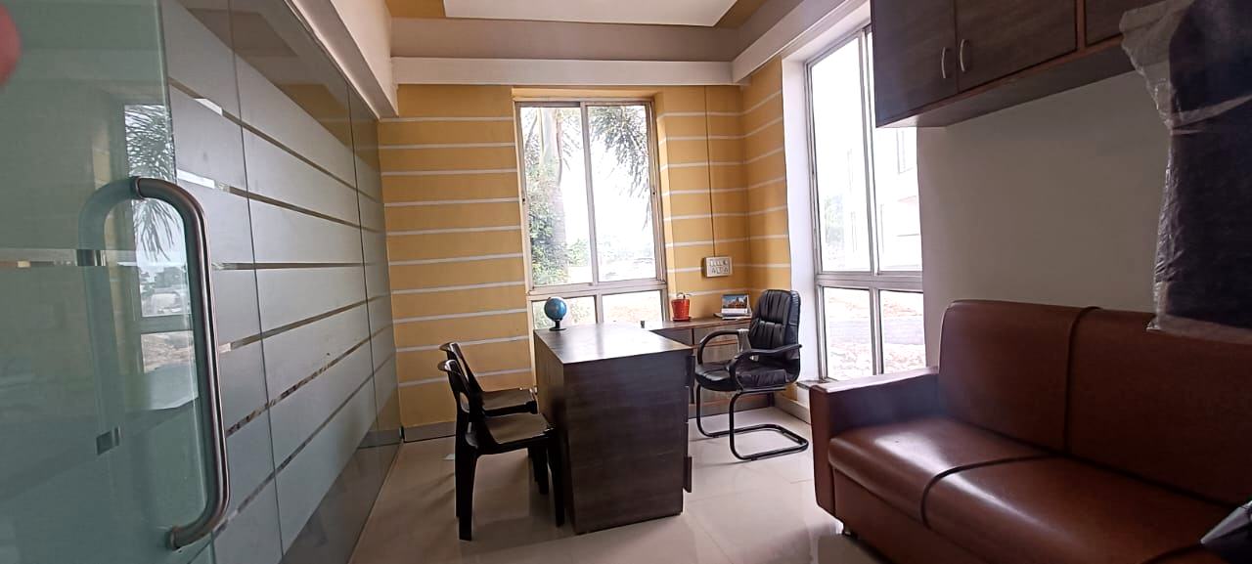
Training & Placement Cell infrastructure facilities – Dean Cabin

Slide 12
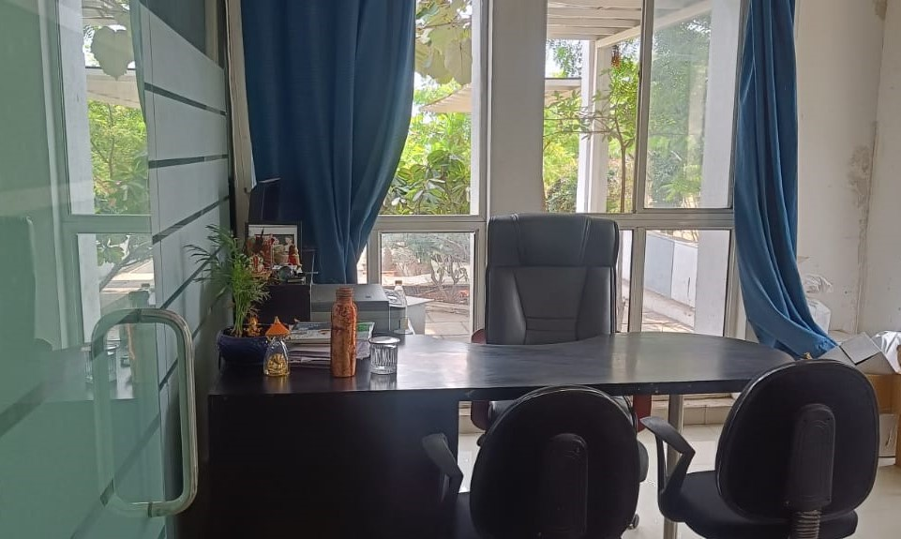
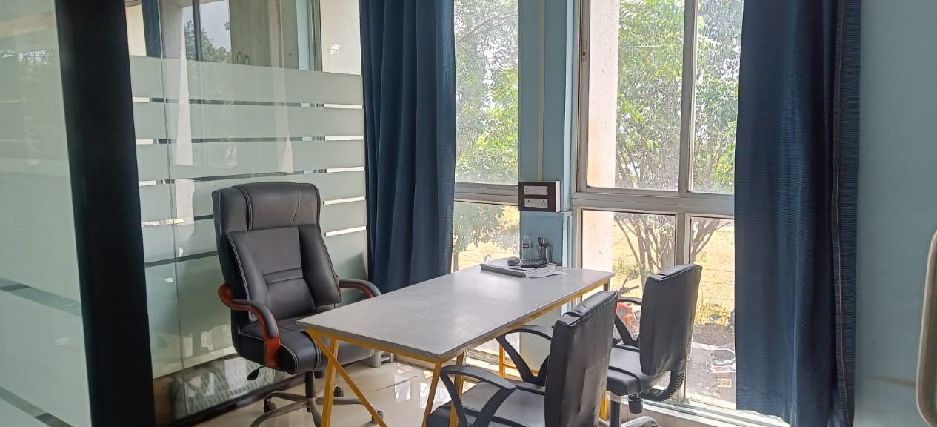
Training & Placement Cell infrastructure facilities – Interview Rooms

Slide 13

Training & Placement Cell infrastructure facilities – Seminar Hall 1

Slide 14

Training & Placement Cell infrastructure facilities – Seminar Hall 2

Slide 15

PLACEMENT PROCESS
Student Profiling
Student skill set
Vs
Skill set requirement
Student opts for multiple industries of their interest
Corporate shortlist the student profile
Placement office matches profile of students & send to corporate
Corporate send their skill set requirement
Corporate visit the campus/student visit the corporate
Aptitude Test/Group Discussion/Interview of shortlisted students by corporate
Offer letter by corporate to the selected students
On boarding
or
student in corporate

Slide 16

Journey of Student Transformation
First Year (FE)
Communication Skill
Personality Development
Goal Setting
Industrial Visit
Second year (SE)
Soft Skill Training
SWOT Analyst
Personality Development

Slide 17
Third year (TE)
Soft Skill Aptitude Training
SQL-PLSQL
Core JAVA/ PYTHON/
MANUAL TESTING
AI-ML
Data Science
Fourth year (BE)
Resume Making
Brush up Basic Knowledge
Sending Basic
data of students to companies
Campus Drive
Online/Offline

Slide 18
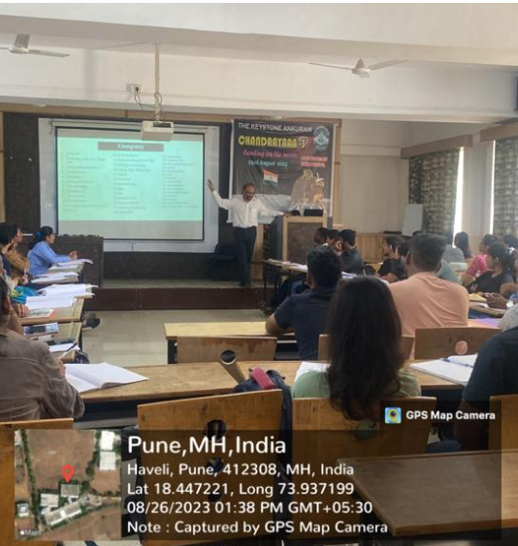
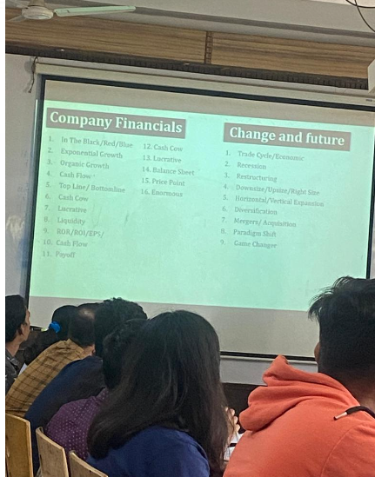
PERSONALITY GROOMING
I. Inhouse Placement Readiness program 1
Public Speaking Skills
Corporate Presentation skills 1 2
Business Vocabulary 1 2 3
Email Writing
Resume Building 1 2 3
Group Discussions 1
Mock Practices
Book Reviews
II. Internship training 1
III. Industrial Visits 1
IV. Foreign languages Training 1
V. FOOT STEPS- The Alumni Talk 1

Slide 19
Our Flagship Programs
Industrial Mentorship Program 1 2
MoUs with Companies 1
Company Specific Training for Technical and aptitude knowledge by External Resources 1 2 3
WOW sessions (Words of Wisdom) 1
Zensar Training 1 2 3 4
FOOTSTEPS_4OUR ALUMNI 1

Slide 20
CORPORATE PERSON VISITED
KEYSTONE SCHOOL OF ENGINEERING
Academic Year | Number of Corporate person visited
2015-2016 | 54
2016-2017 | 48
2017-2018 | 50
2018-2019 | 23

Slide 21


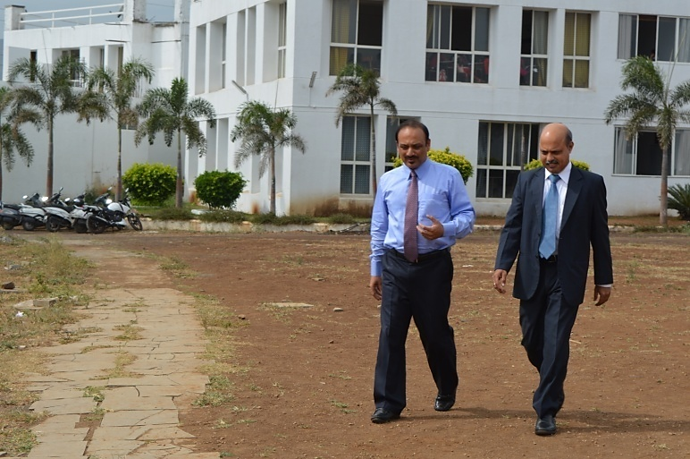
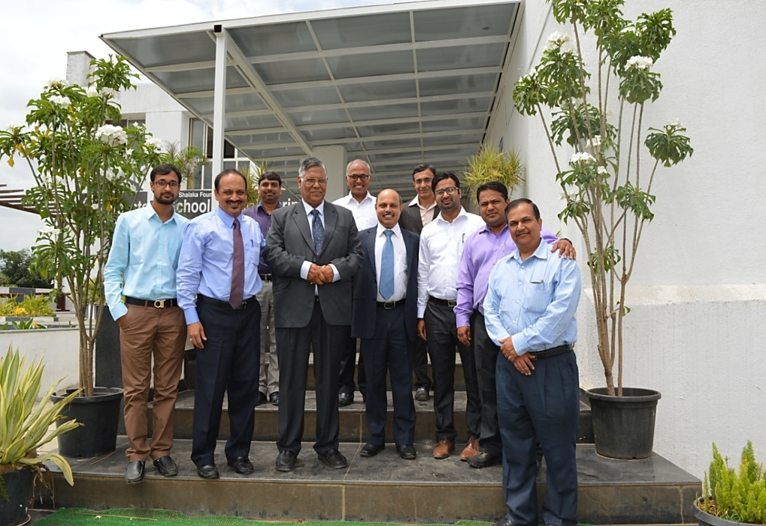
M. S. Unnikrishnan Managing Director & CEO at Thermax
Experience
Managing Director & CEO at Thermax
Executive Vice President Thermax

Slide 22

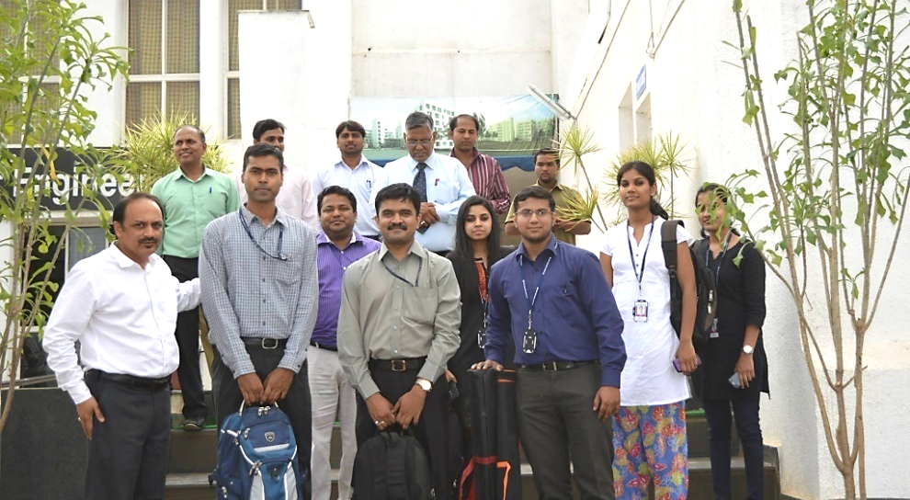

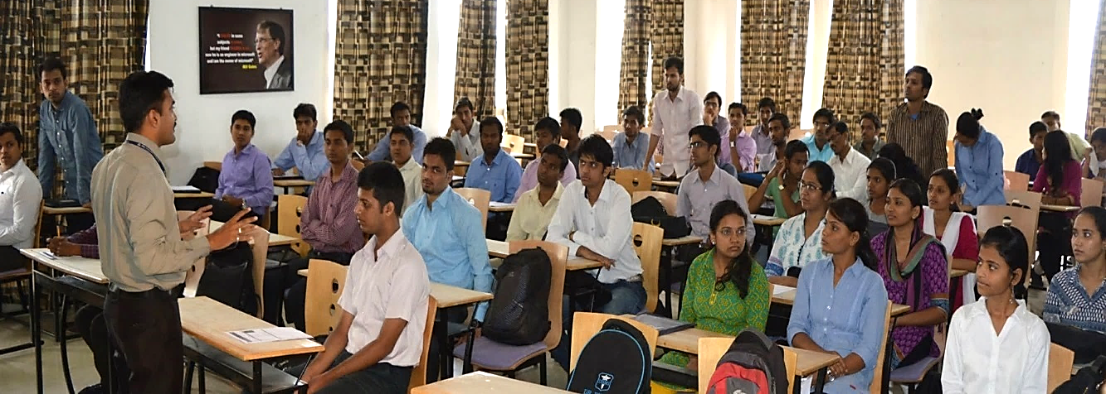
Suyog Bhandekar Campus Recruitment Lead at Tata Consultancy Services
Experience:
Tata Consultancy Services
Persistent Systems Limited , Pune
Geeks Software Pvt. Limited

Slide 23


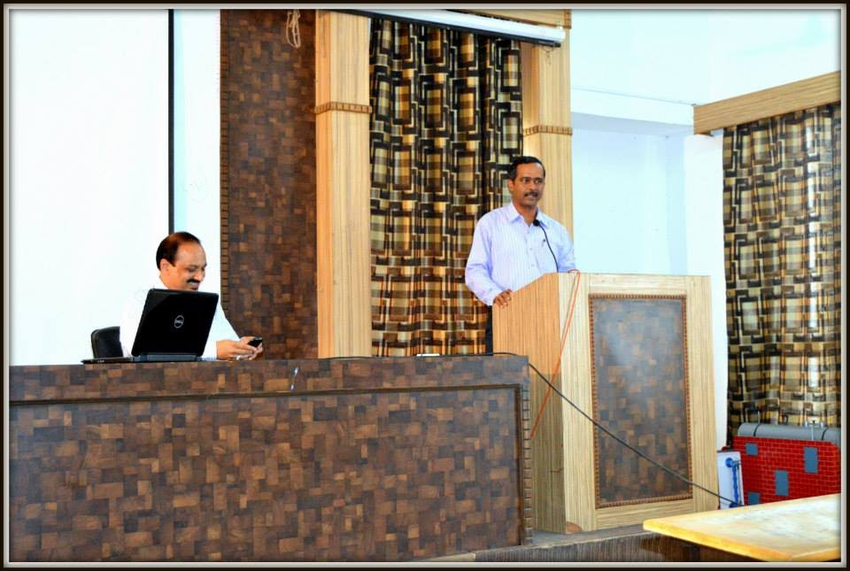
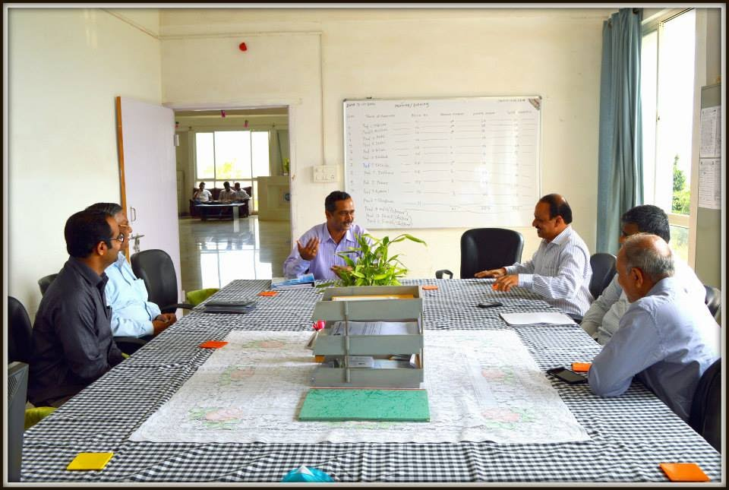
Mr. Vikas Chimadi Sr. Manager HR at Emerson Network Power Italia, Pune
Experience
Sr. HR Manager at Emerson Network Power Italia, Pune

Slide 24

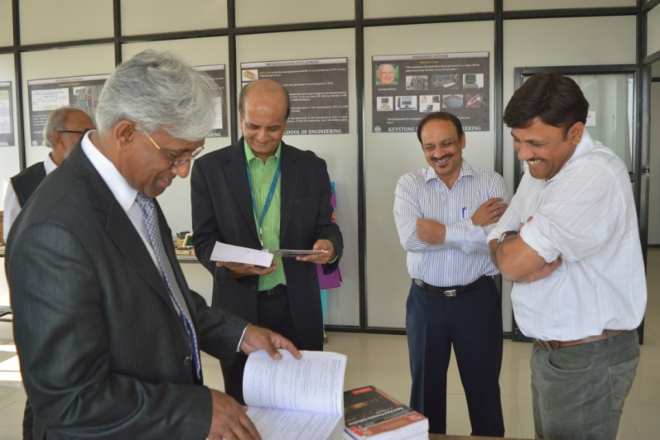
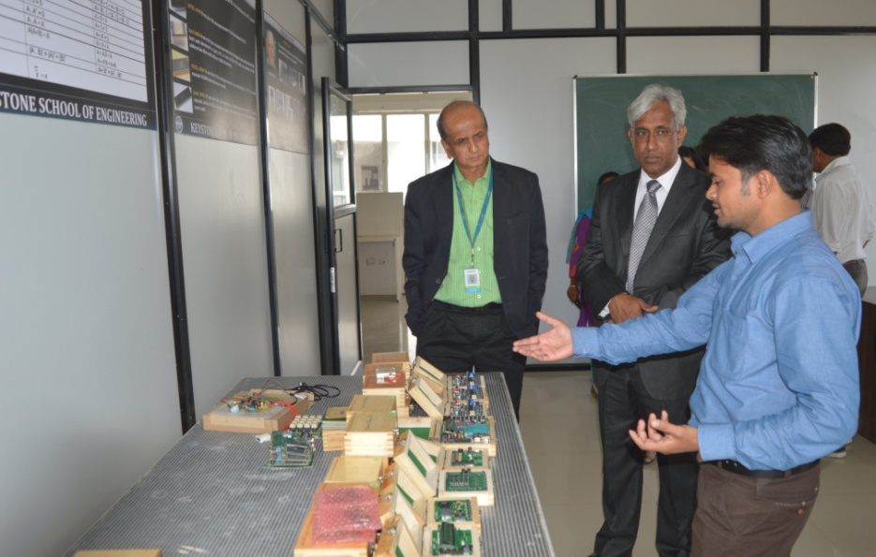
Acharya K. N. S, Vice President & Global Head of Education & Competency Development at KPIT Technologies Ltd.
Experience
Associate Vice President - Education, Training & Assessments (Engineering Services) Infosys Ltd
Chief Learning Officer (Learning Lead), Honeywell Technology Solutions, Inc.
Dean - Postgraduate Engineering Programmers,
M.S Ramaiah School of Advanced Studies
Assistant Professor - Mechanical Engineering, SDM College of Engg & Tech

Slide 25



Mr. Rajendra Kango Sr. Manager at KPIT Cummins
Ms. Renuka Krishna HR at KPIT Mahindra-British Telecom Ltd.

Slide 26

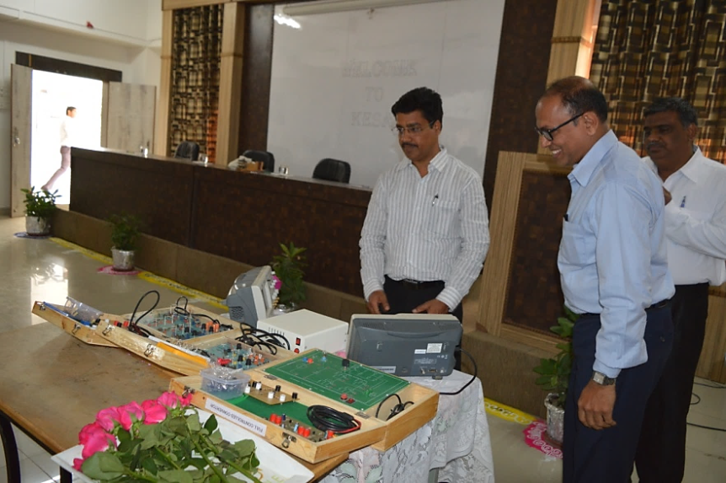

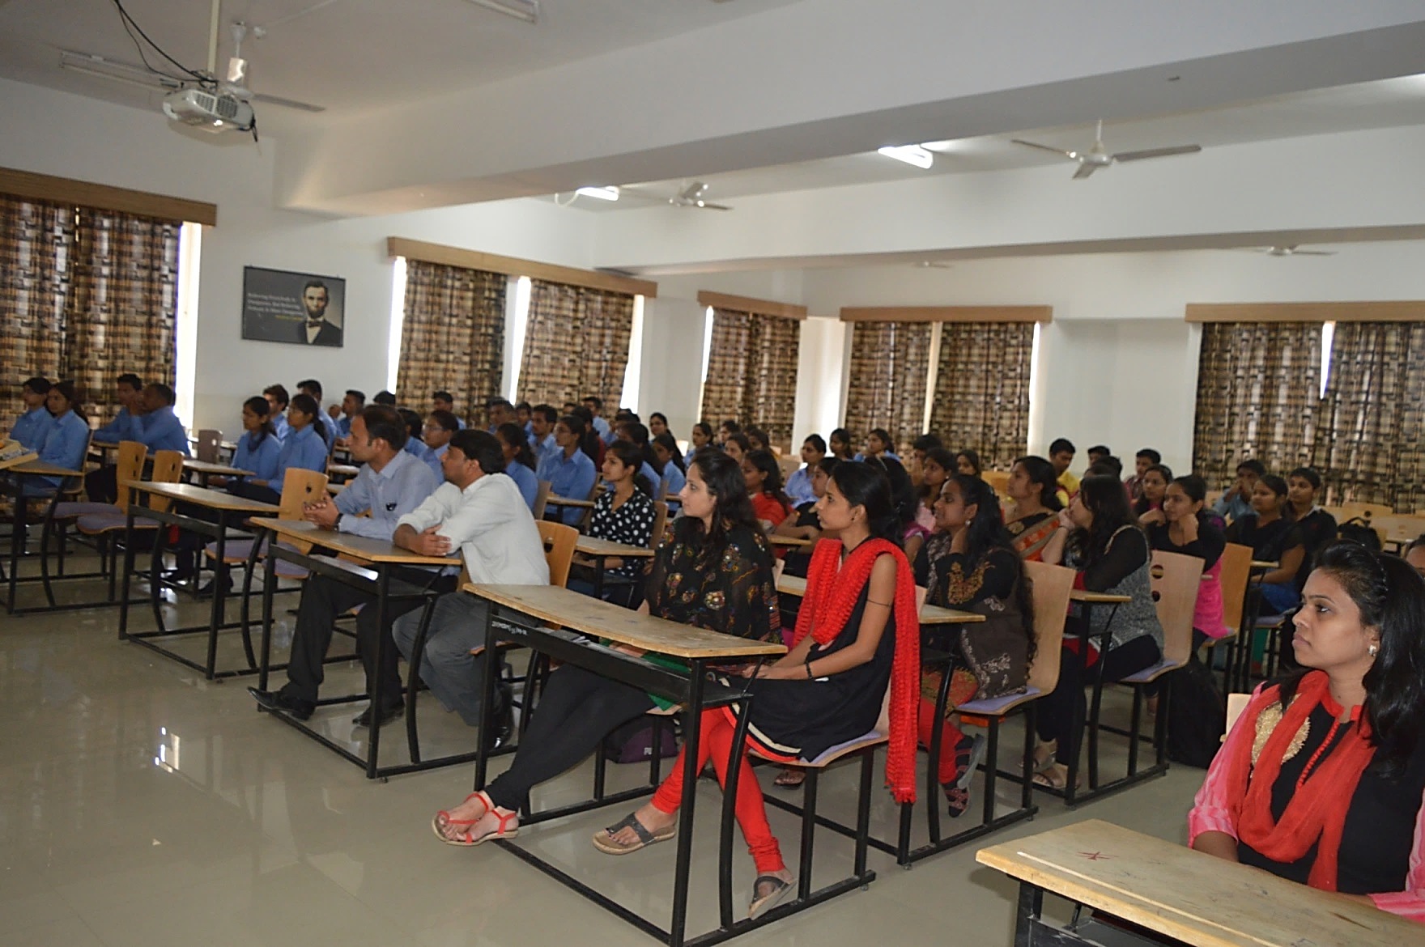
Mr. Rajesh Sharma
Learning & Development at Suzlon Energy

Slide 27


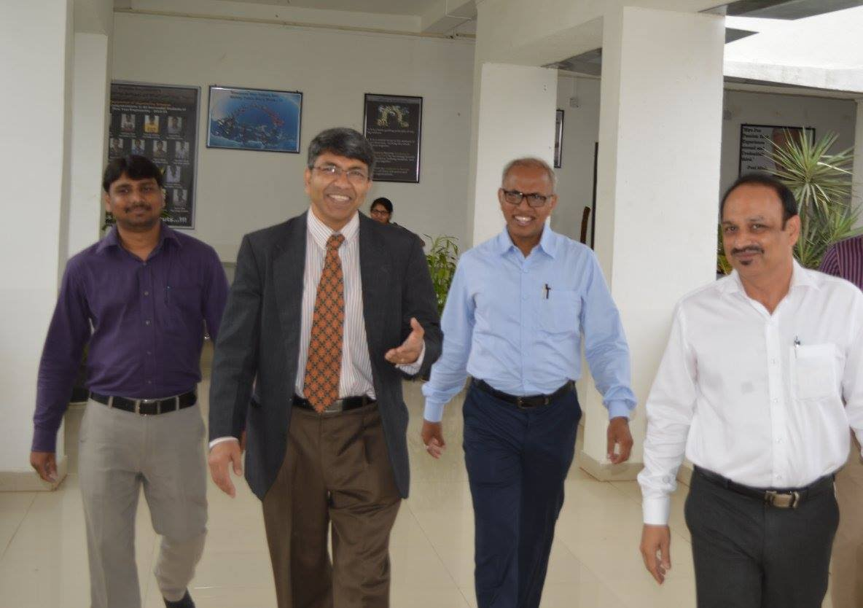
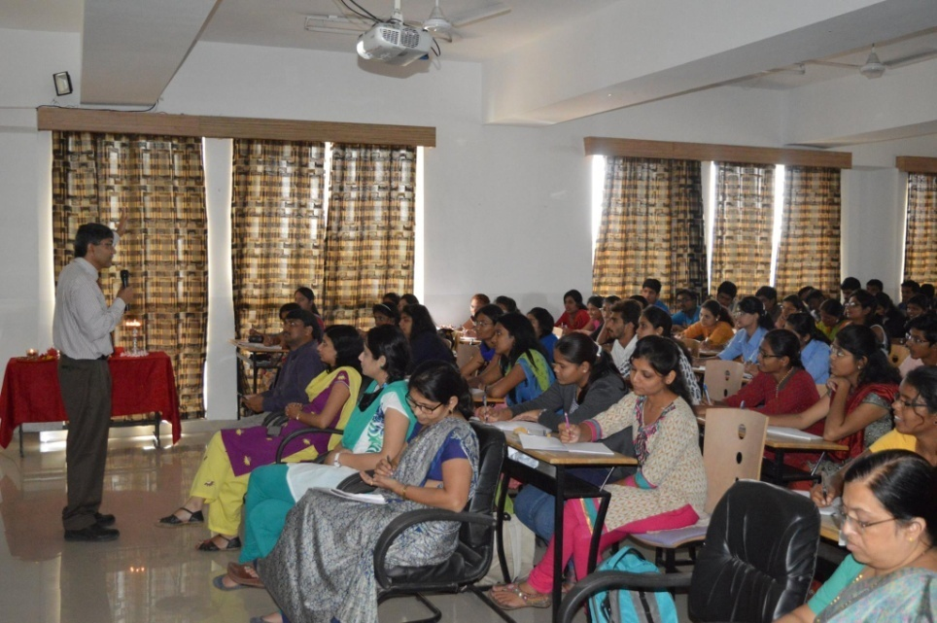
Dr. Ravindra Utgikar Vice President, PRAJ Industries Ltd.

Slide 28



Mr. Sandeep Sohoni Associate Manager - HR at Atos
Experience
Business Partner – HR, Persistent Systems
Executive-Human Resources, Persistent Systems
HR Executive, Tieto (Previously Tieto Enactor)
NSR Placement Services
Trainee HR, Aztec soft

Slide 29



Mr. Ashfak Shaikh Senior Technical Services Manager, IBM
Experience
Advisory Project Manager,
IBM
Team member, CDS
Service Delivery Manager, Wipro Technologies
Team Manager,
P&O Nedlloyd
Team Lead, Zensar
Technologies

Slide 30


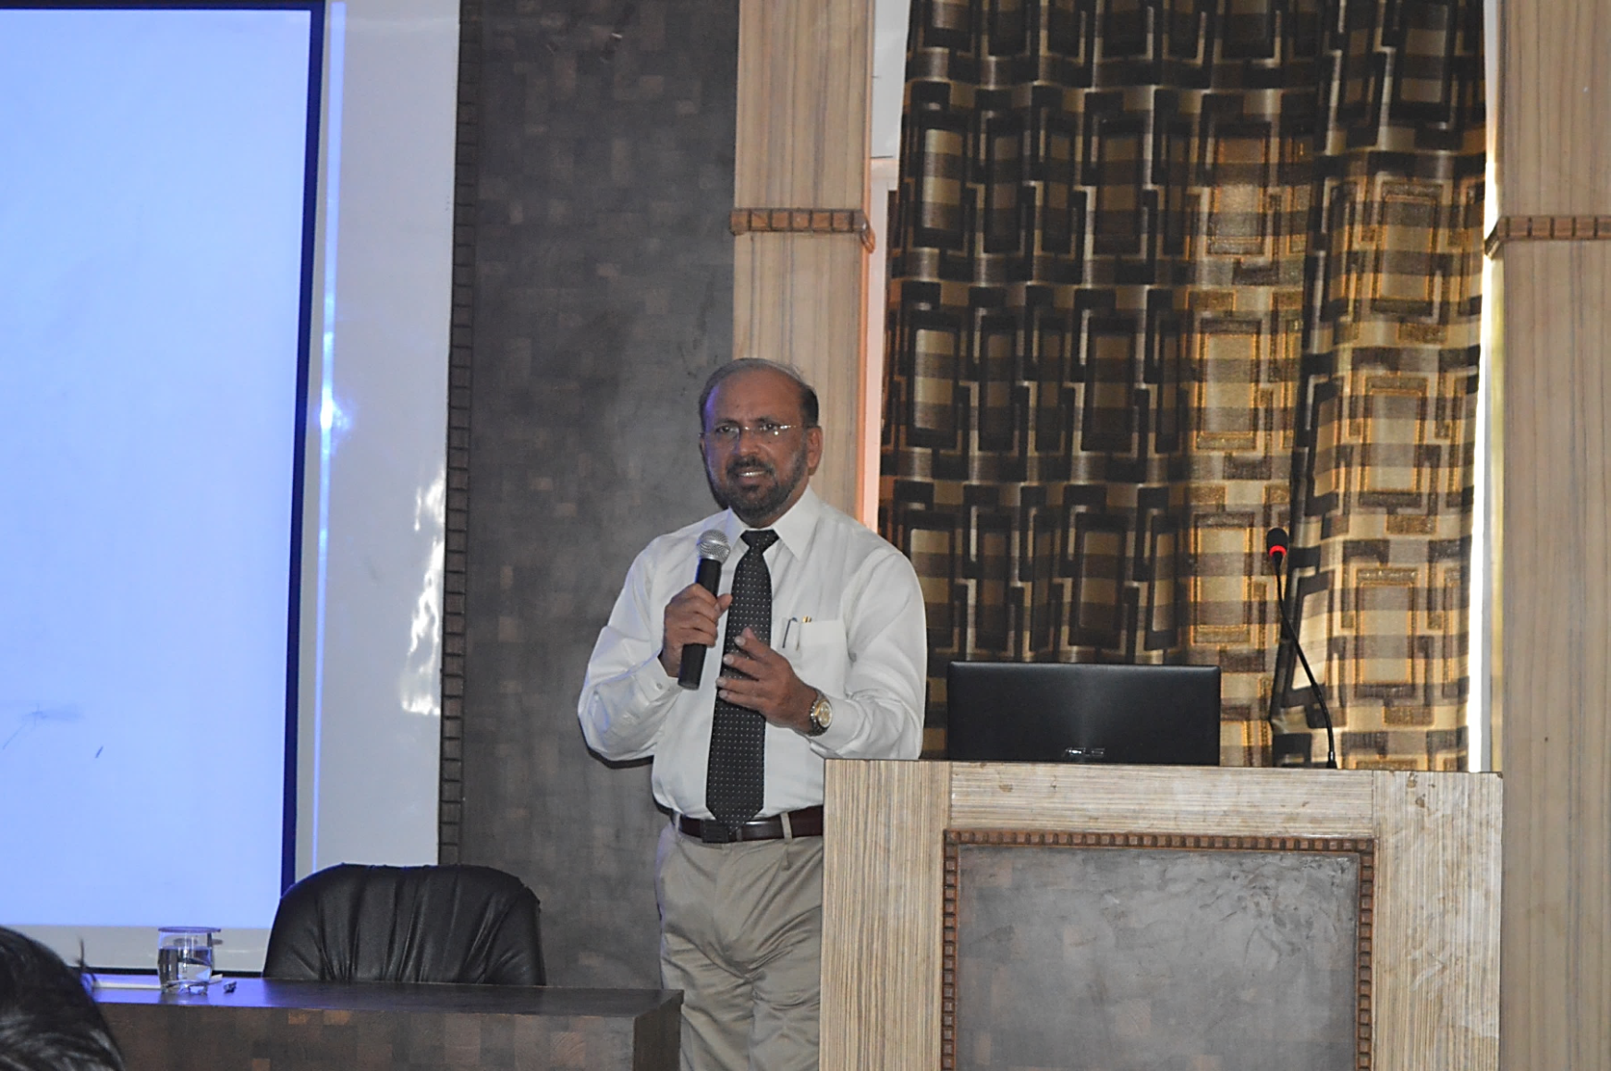
Mr. G.K. Pillai
Managing Director & CEO
Walchandnagar Industries
Managing Director & CEO
Walchandnagar Industries Ltd. Pune
Chairman & Managing Director
HMT Machine Tools Ltd. Bangalore
Chairman & Managing Director (Retd)
Heavy Engineering Corporation Ltd. Ranchi
Chief ExecutiveTyco Sanmar Limited
Chief Executive
FISHER SANMAR LIMITED
Vice President(Business Dev & Sales)
Chemtrols Engineering Limited
Dy General Manager
Instrumentation Ltd. Palghat
Experience

Slide 31


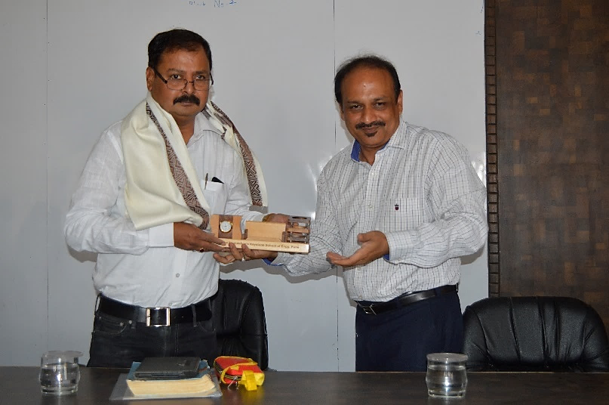
Mr. Laxmikand Kshirsagar General Manager Ms. Deepshikha Bhoumik HR Manager

Slide 32


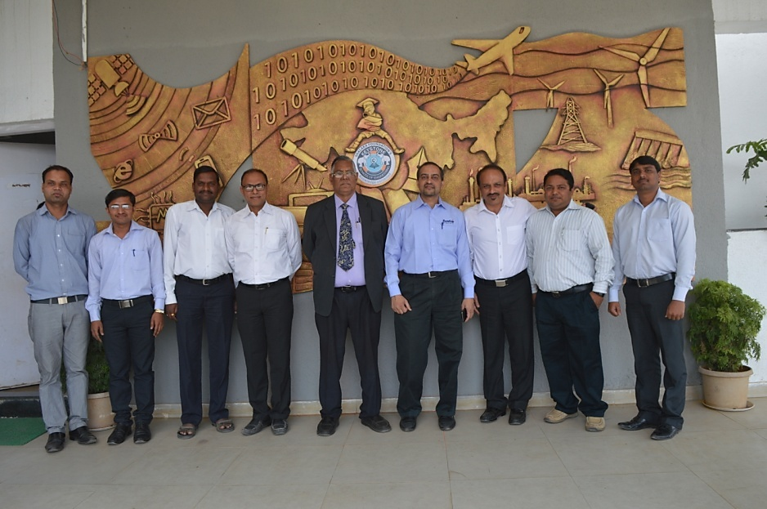
Sanjyot Khare, AVP, Head-Technical Training & Competency Center at Zensar Technologies
Experience
AVP, Head - Microsoft Practice and Delivery Head, Zensar Technologies
Project Manager, Pinestar Technologies, Inc - New Jersey
Team Leader (Debt Management), CIT Group, New York
Software Engg, Atos Origin

Slide 33



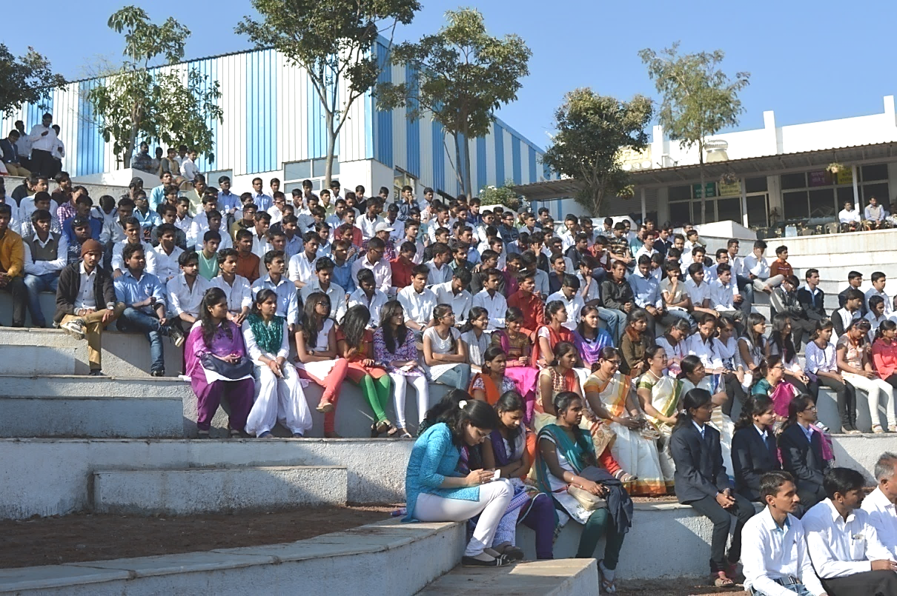
Mr. Vignesh Padmanabhan Director Channel Sales at Siemens

Slide 34
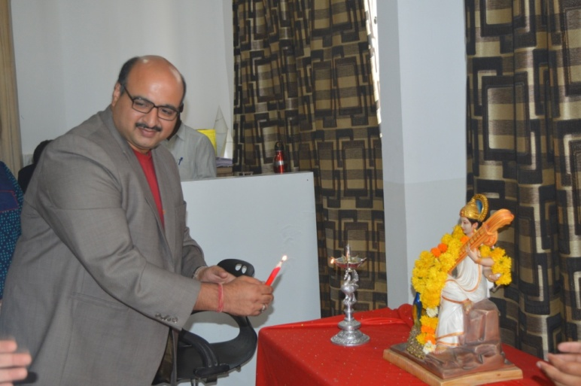

Mr. Himanshu Goyal,
Country Manager,
IBM
Experience
IBM Corporate Services Corps
Indians first Digital Library for INSA, New Delhi
The Great Mind Challenge (TGMC)
Digital Restoration of Publisher Content of Leading 5 National Newspapers
IBM Devolution

Slide 35


Ms. Sheetal Soni
Country Channel Manager, IBM India Pvt Ltd
Experience
Country Channel Manager
IBM India Pvt Ltd
Product Manager
NIIT Ltd
Territory Head
NIIT Ltd.
Centre Head
NIIT Ltd
Territory Marketing
Delivery Executive
NIIT Ltd

Slide 36

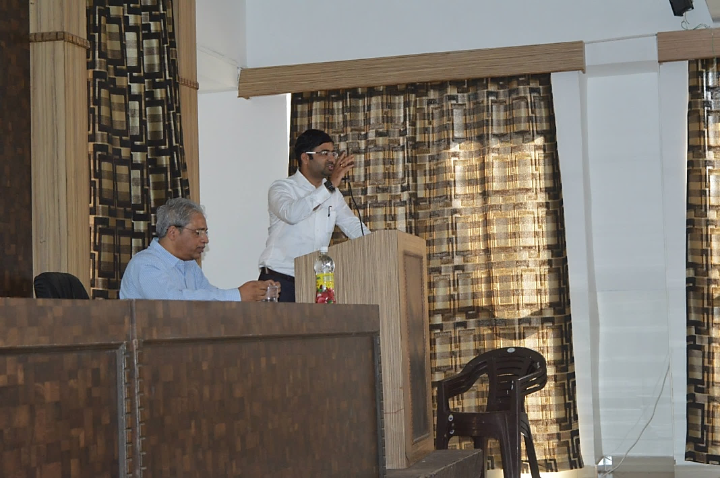

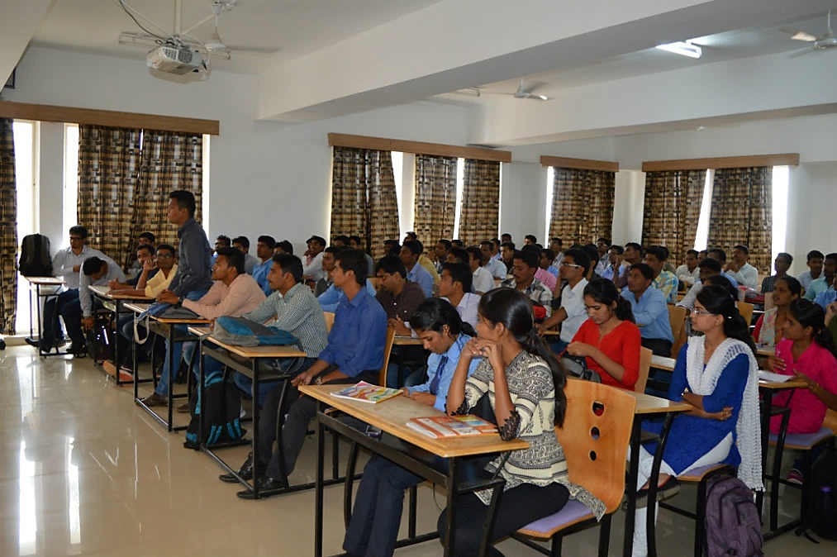
Kaustubh Bhadbhade
Senior Manager - Human Resources at Persistent

Slide 37




Mr. Amit Bhingurde- Chief Operating Officer -TAL Manufacturing Solutions Limited
Experience
COO, TAL Manufacturing Solutions Limited
President & CEO, Kuka India
Divisional Manager,
Tata Motors Ltd, Pune

Slide 38
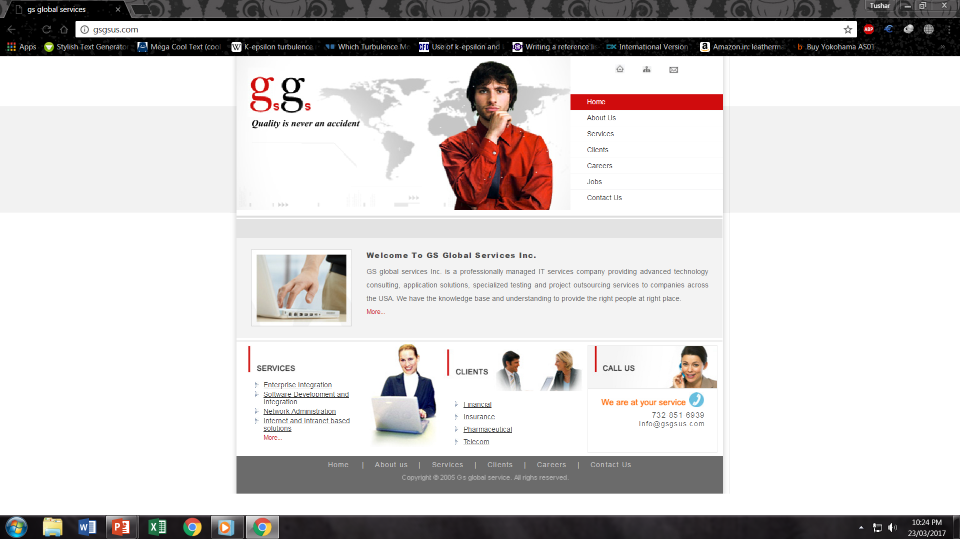



Pankaj Mishra
Managing Director
GsGs United states

Slide 39

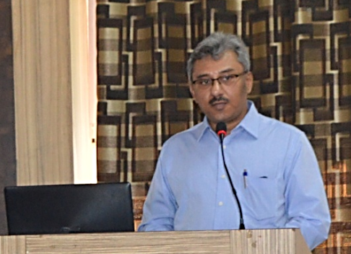
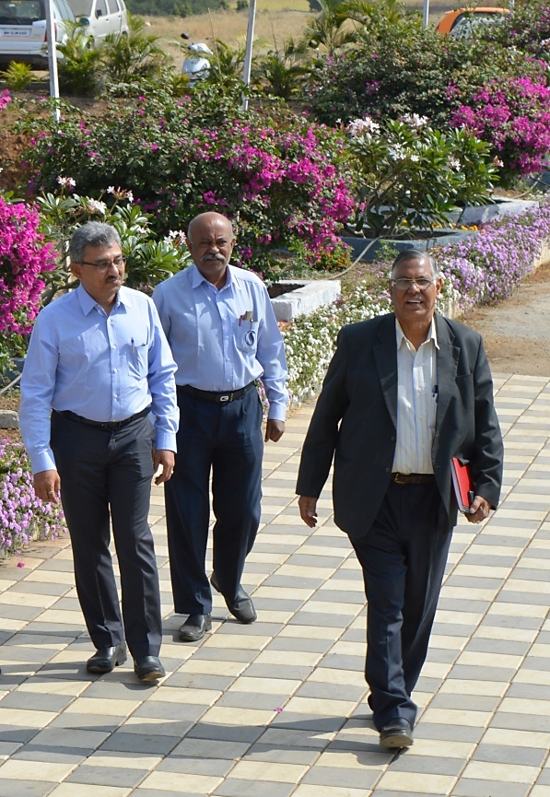

Rajesh Suttatti
Managing Director at Sumax Enterprises Pvt. Ltd.

Slide 40
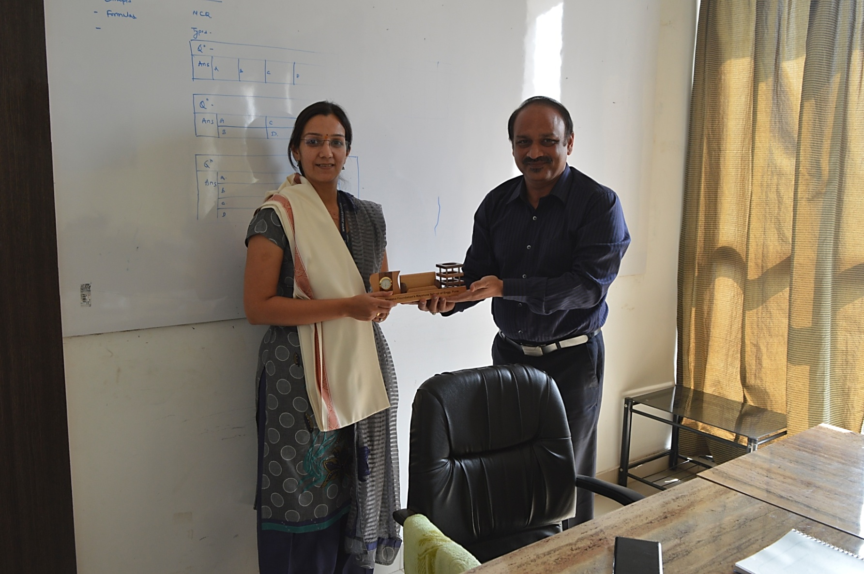
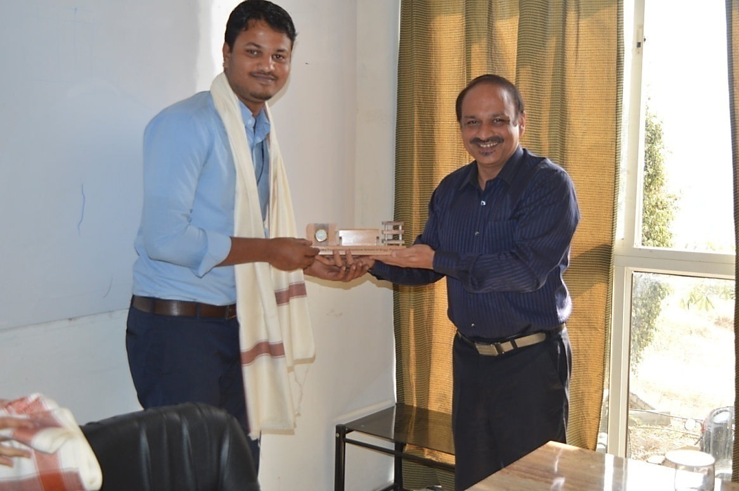
Mrs.Sonali Kelkar
Associate Manager at Zensar Technologies Ltd.
Mr.Taher Khan
Executive at Zensar Technologies

Slide 41

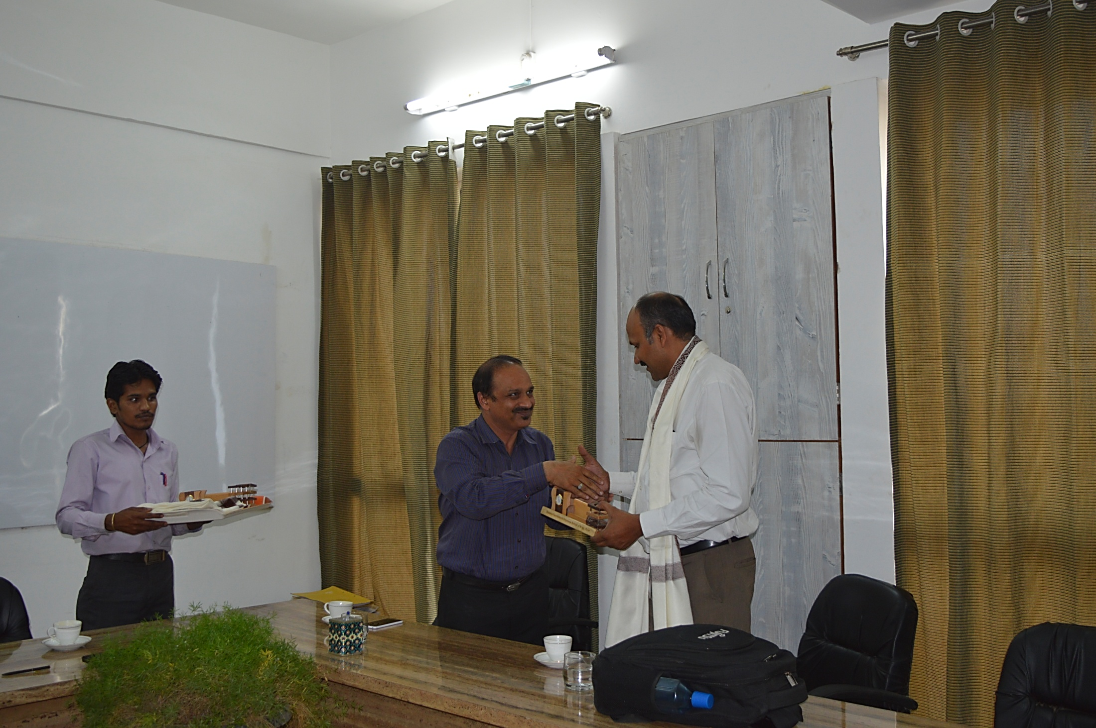
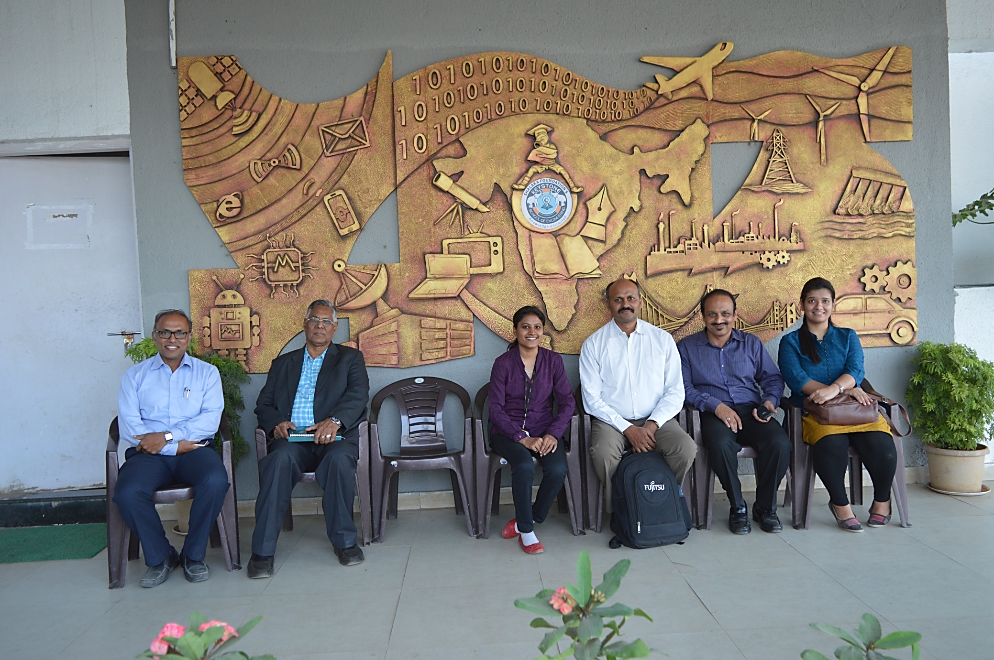
Jacob Mathew
Manager -Human Capital Development
Fujitsu Consulting India

Slide 42

Sadanand Poorajan , Nitin A. Choudhari , Subrata Bhattacharjee & Swanand Deo
Fujitsu Consulting India

Slide 43


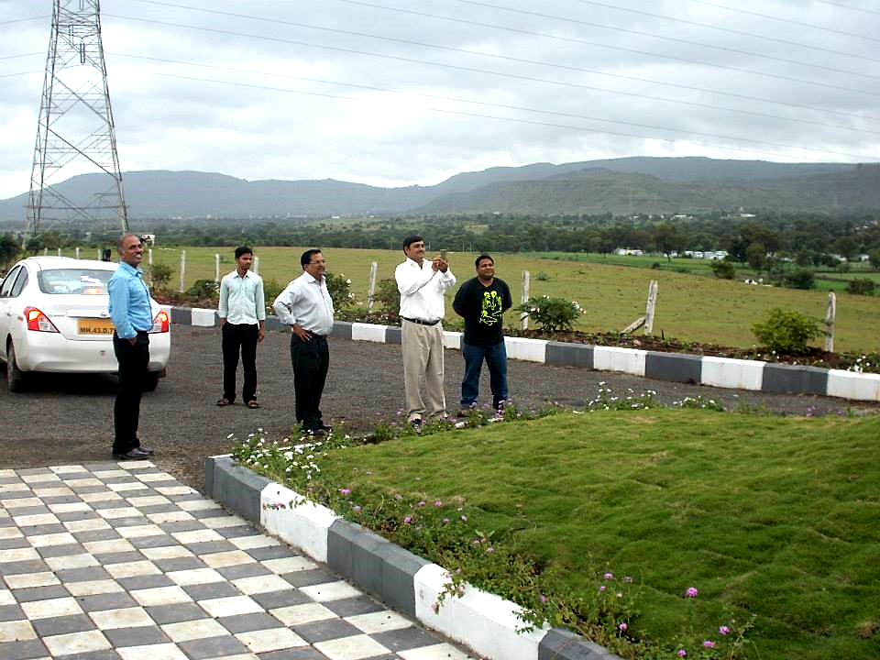
Mr. Bhavin Bhatt
HR Head At L&T Infotech
Experience
Manager – HR L&T Power
Planning Engineer Nokia Siemens Networks

Slide 44
Training & Placement cell Achievements
Total offers till date (Last 5 Years-2017 to 2022) : 475
Opportunity provided to students with Highest salary : 30 Lacs.
Recruitment Drives each year : Around 150 (online + Offline)
Practically all the companies in Pune region are recruiting our students including IT Companies like INFOSYS, TCS, TECH MAHINDRA, CAP GEMINI, KPIT, COGNIZANT, ATOS SYNTEL, PERSISTENT, FUJITSU, WIPRO and many others recruit students of KSE.
Reputed core companies like FORCE MOTOR, TATA TECHNOLOGIES, KNORR-BREMSE, MAHLE ANAND, GODREJ, KSB PUMPS, ALFA LAVAL, GE, VOLKSWAGEN, ATLAS COPCO, FORBES MARSHALL, TATA COMMUNICATION, TETRA PAK, KONECRANES, KIRLOSKAR, SIEMENS, SKF, THYSSENKRUPP INDUSTRIES, TATA PROJECTS LTD, L&T TECHNOLOGIES and many others recruit students of KSE.

Slide 45


Slide 46
KEYSTONE SCHOOL OF ENGINEERING
181
Academic Year
2017-2018
MECH
102
COMP
42
E&TC
37
249
MECH
134
COMP
70
E&TC
45
Academic Year
2018-2019
Number of Students Graduated
206
MECH
103
COMP
60
E&TC
43
Academic Year
2019-2020
182
MECH
80
COMP
68
E&TC
34
Academic Year
2020-2021
219
Academic Year
2021-2022
MECH
82
COMP
69
E&TC
68

Slide 47
Training
Academic Year |  | Mechanical | COMPUTER | E&TC
2017-18 | No. of Students | 102 | 42 | 37
 | Trained | 53 | 42 | 34
2018-19 | No. of Students | 130 | 68 | 51
 | Trained | 30 | 68 | 46
2019-20 | No. of Students | 116 | 60 | 43
 | Trained |  | 60 | 43
2020-21 | No. of Students | 80 | 68 | 20
 | Trained |  | 68 | 20
2021-22 | No. of Students | 82 | 70 | 68
 | Trained |  | 70 | 68
2022-23 | No. of Students | 108 | 73 | 63
 | Trained | 4 | 73 | 20

Slide 48
PLACEMENT

Slide 49
Year wise Reprentation of Placed Students From 2017 To 2022

Slide 50





2022 PLACEMENT REPORT
KEYSTONE SCHOOL OF ENGINEERING
219 STUDENTS
Rs. 30 L.HIGHEST PACKAGE
202 PLACED
93.60%

Slide 51
KEYSTONE SCHOOL OF ENGINEERING
2021 PLACEMENT REPORT
182 STUDENTS
Rs. 5.6L.HIGHEST PACKAGE
176 PLACED
96.70%

Slide 52
KEYSTONE SCHOOL OF ENGINEERING
2020 PLACEMENT REPORT
Rs. 5.6L.HIGHEST PACKAGE
206 STUDENTS
197 PLACED
95.63%

Slide 53
KEYSTONE SCHOOL OF ENGINEERING
2019 PLACEMENT REPORT
249 STUDENTS
Rs. 5.6L.HIGHEST PACKAGE
239 PLACED
95.93%

Slide 54
KEYSTONE SCHOOL OF ENGINEERING
2018 PLACEMENT REPORT
167 STUDENTS
Rs. 5.6L.HIGHEST PACKAGE
157 PLACED
95.93%

Slide 55





Company Wise Placement details
Academic Year | Company Names | Number of Placed Students
2021-22 |  | 14
 |  | 9
 |  | 7
 |  | 7
 |  | 7

Slide 56





Company Wise Placement details
Academic Year | Company Names | Number of Placed Students
2021-22 |  | 4
 |  | 5
 |  | 3
 |  | 4
 |  | 2

Slide 57



Company Wise Placement details
Academic Year | Company Names | Number of Placed Students
2020-21 |  | 3
 |  | 7
 |  | 4
 |  | 3
 |  | 2

Slide 58


Company Wise Placement details
Academic Year | Company Names | Number of Placed Students
2019-20 |  | 5
 |  | 5
 |  | 3
 |  | 3
 |  | 2

Slide 59



Company Wise Placement details
Academic Year | Company Names | Number of Placed Students
2018-19 |  | 4
 |  | 5
 |  | 6
 |  | 5
 |  | 4

Slide 60


Company Wise Placement details
Company Wise Placement details
Academic Year | Company Names | Number of Placed Students
2017-18 |  | 6
 |  | 7
 |  | 5
 |  | 2
 |  | 4

Slide 61

COMPANIES WHERE STUDENTS ARE PLACED

Slide 62
Higher Studies
Some of the Students have not opted for placement as they want to pursuing overseas education
During the last year following four students have gone for higher studies in abroad
SR.NO | NAME | BRANCH | COUNTRY
1 | SATYAM SINGH | BE COMP | USA
2 | SSANIDHYA BARAPATTE | BE E&TC | USA
3 | AMIT SHINDE | BE MECH | CANADA
4 | KARTIK SHINDE | BE MECH | CANADA
We normally Keep brochures for foreign universities
(CANADA,USA,AUSTRALIA,& NEW ZEALAND ) in library where
the students can refer the brochures

Slide 63
ENTREPRENEURSHIP
Many of students rather than working for companies they start their own ventures
The following students have started their own ventures
VIKAS SHARMA
VISHAL ANAND (Sports Academy)

Slide 64
Thank You
on Behalf
of
Training & Placement Cell
Bharat Bhushan Sud
bbsud1@gmail.com
Mobile: 9822038944

